Slide 1
Notes:
This deck is designed to help you discuss Cybersecurity Awareness Month and your organization’s cybersecurity posture with your leadership.
Use this deck to discuss:
What Cybersecurity Awareness Month is and why your organization should participate
Why cybersecurity (especially for critical infrastructure) matters
Where your organization stands regarding the cybersecurity best practices that CISA recommends every organization put in place
You can also use this deck to initiate a discussion with leadership about the organization’s current practices and policies, as well as any areas for improvement.

Slide 2
Cybersecurity
Best Practices
For [your organization’s name]

Slide 3
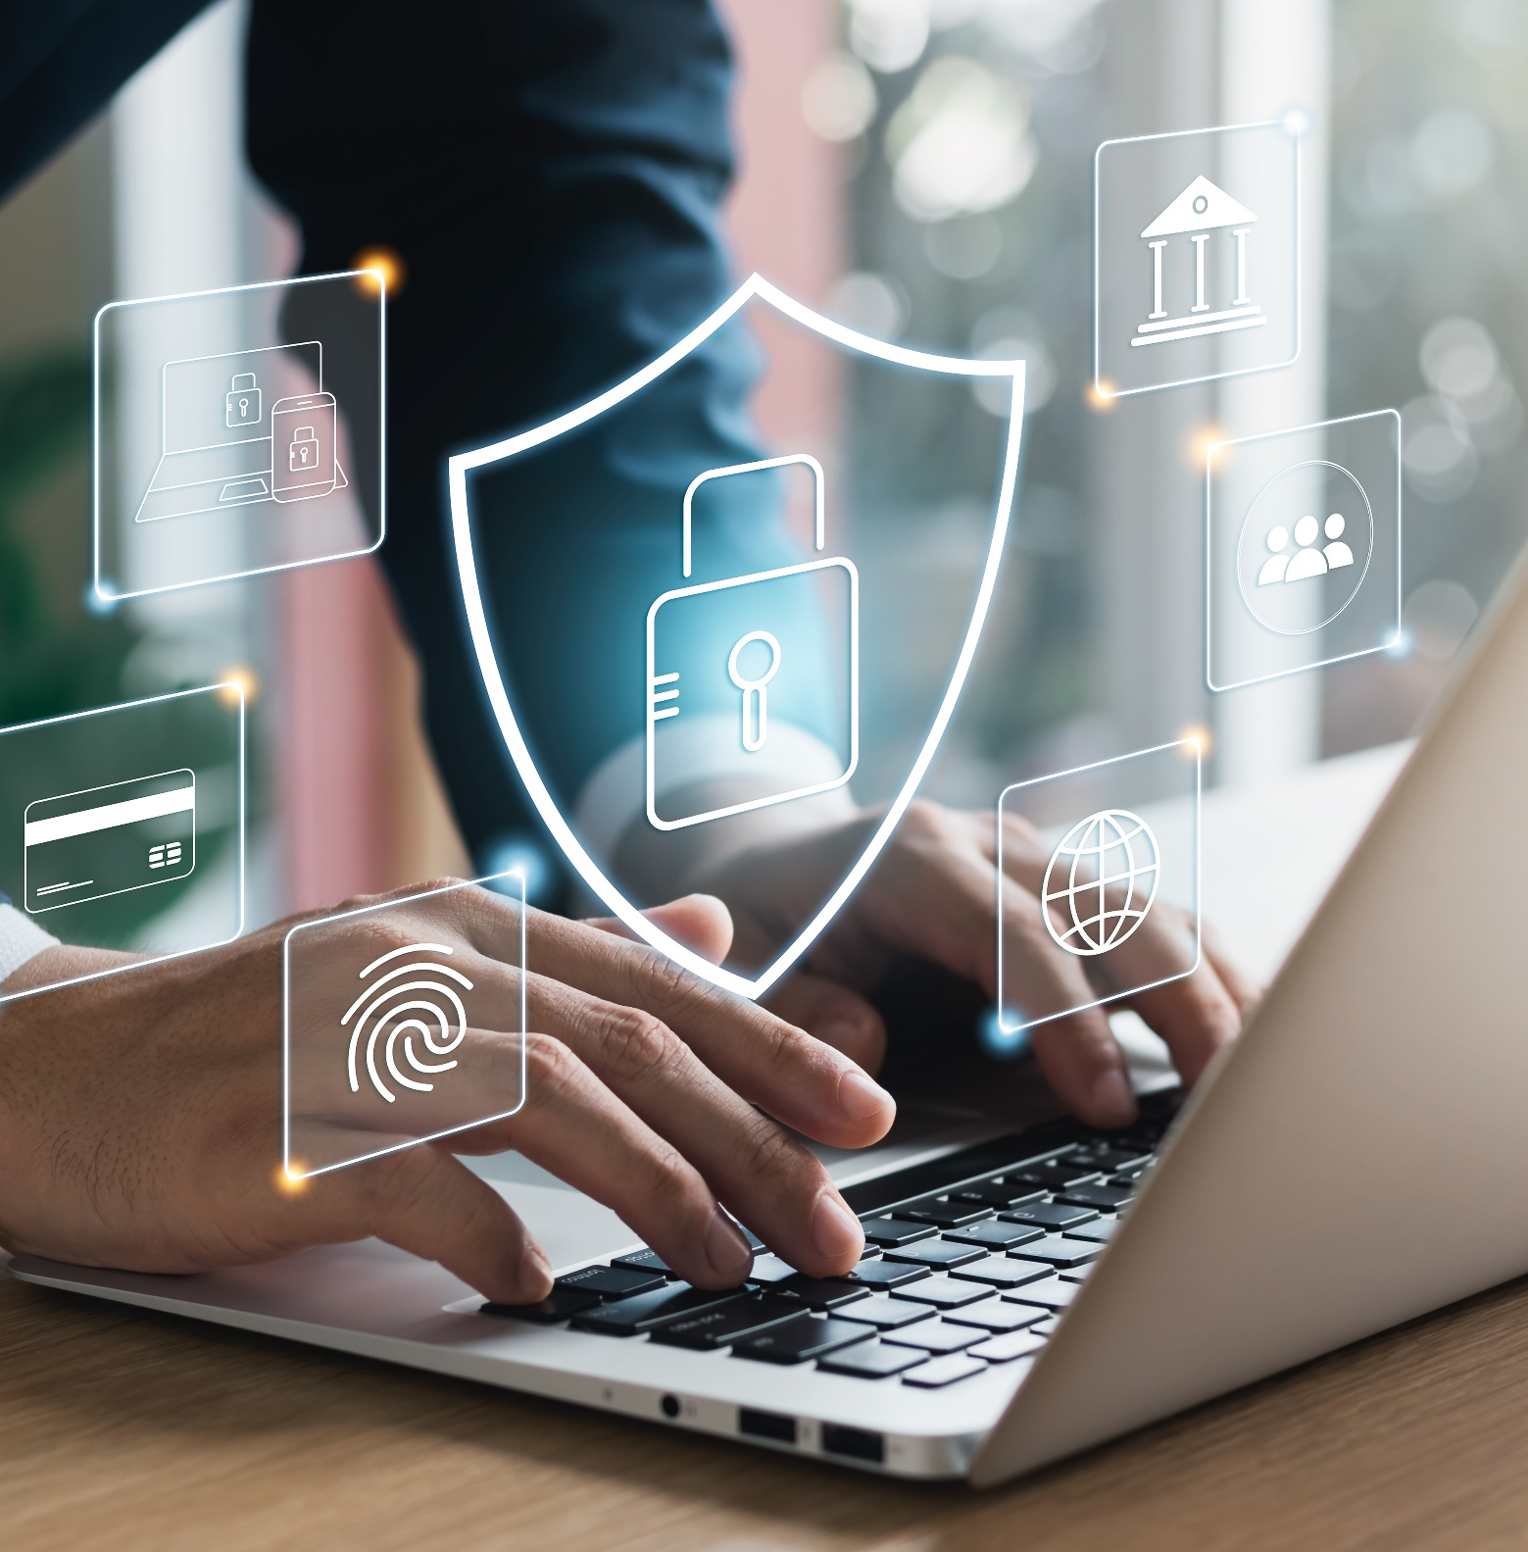
Roadmap
What Cybersecurity Awareness Month is and why [your organization’s name] should participate
Why cybersecurity matters
Where we stand regarding the cybersecurity best practices that CISA recommends for organizations that own, operate, supply, support, or otherwise connect with critical infrastructure

Slide 4
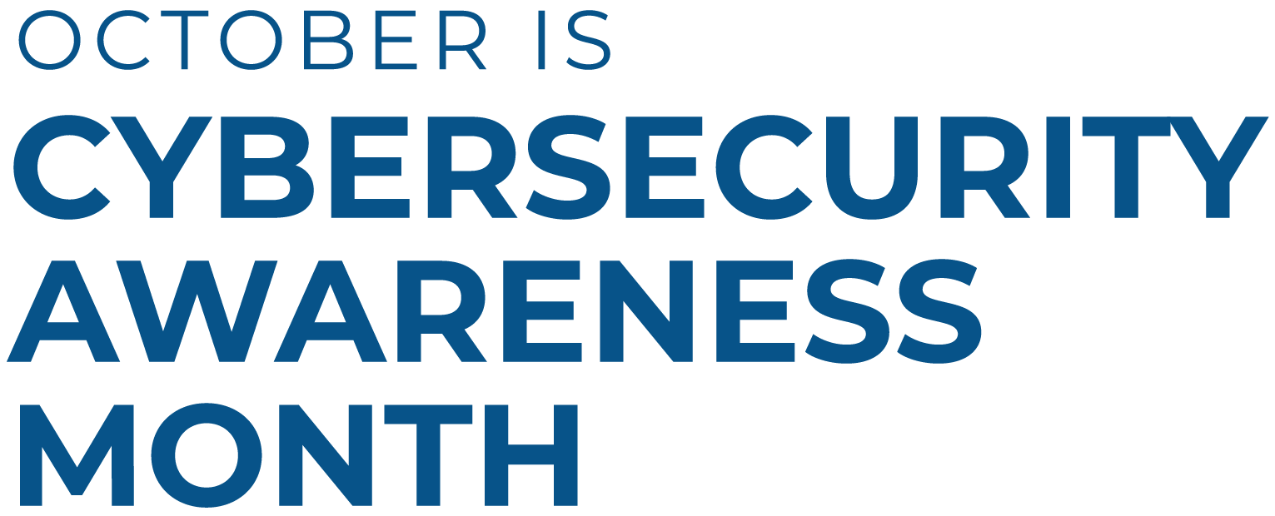

Slide 5
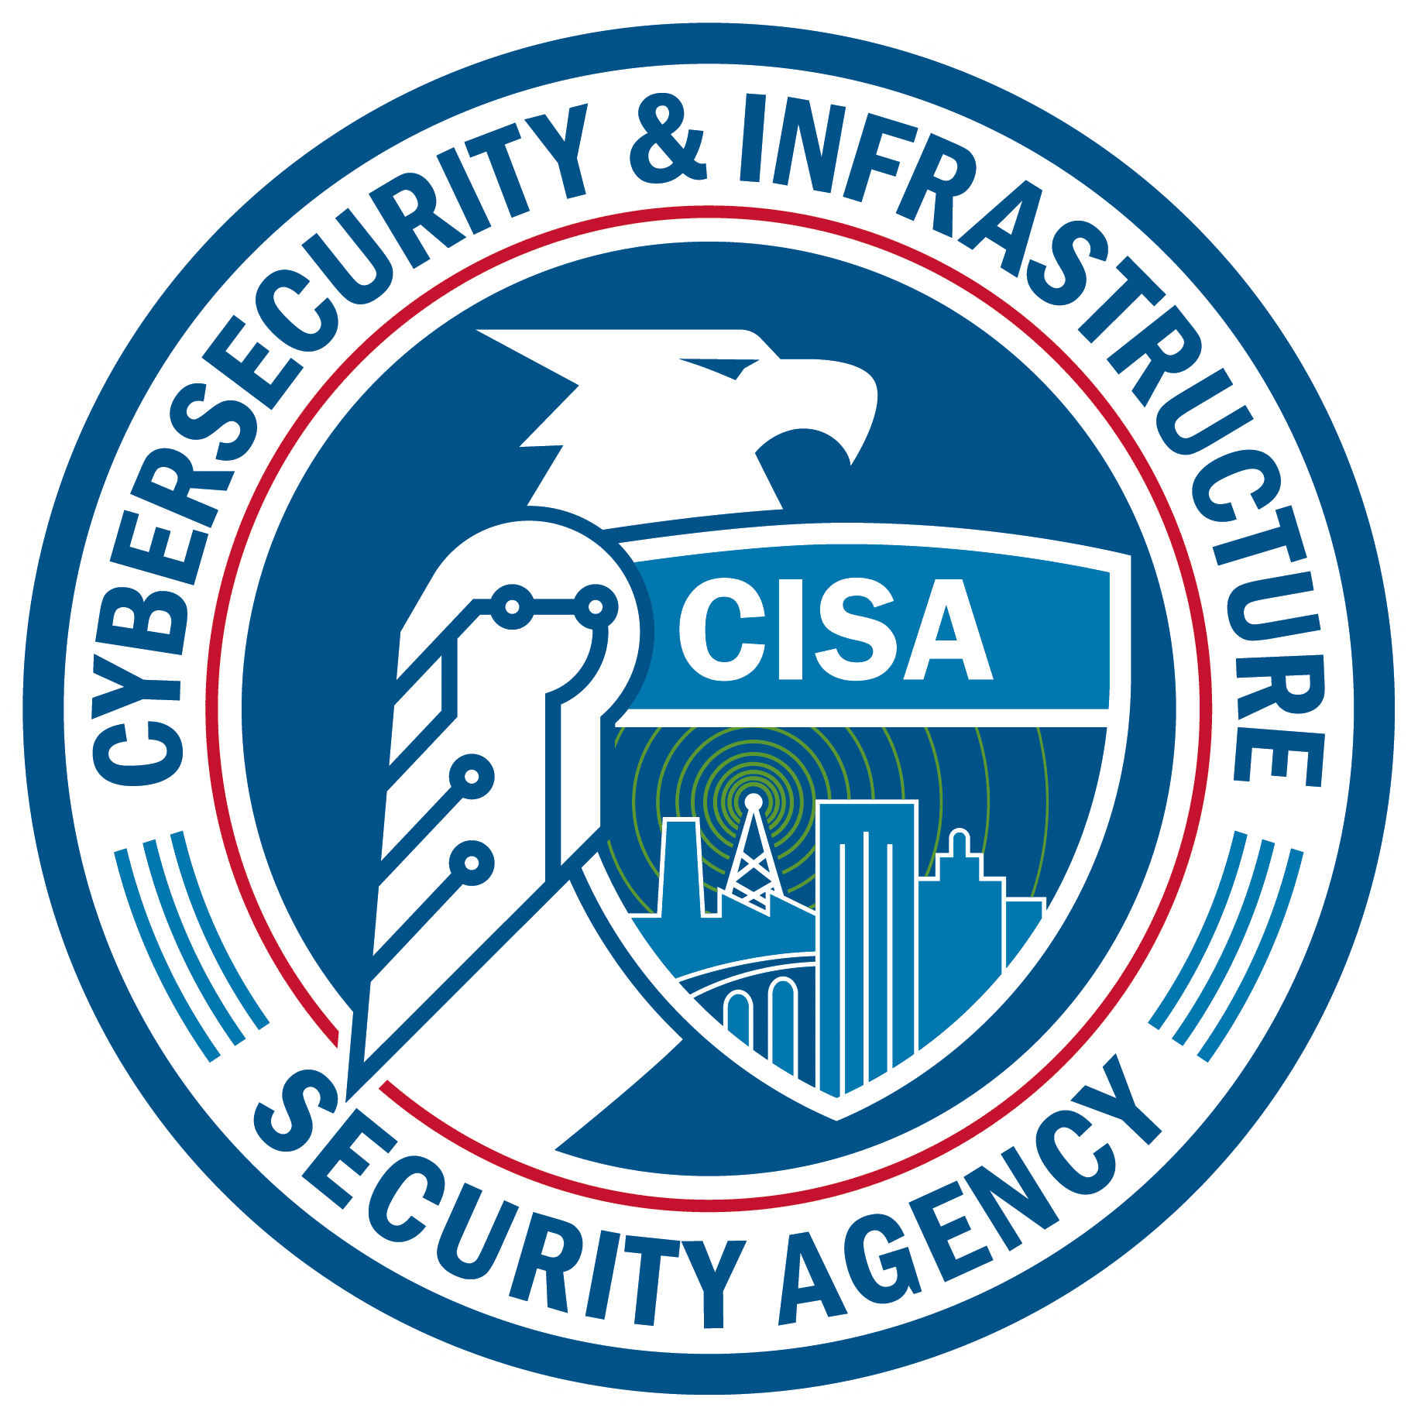
Cybersecurity Awareness Month
October is Cybersecurity Awareness Month! For more than 20 years, this awareness campaign has highlighted the importance of taking daily action to reduce risks when online and using connected devices.
The 2025 theme is Building a Cyber Strong America, highlighting the need to strengthen the country's infrastructure against cyber threats, ensuring resilience and security.
This year, the focus is on the government entities and small and medium businesses that play a role in keeping the nation’s critical infrastructure running.

Slide 6

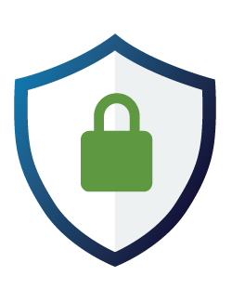
Why cybersecurity matters
Many organizations are directly or indirectly connected to critical infrastructure.
If an organization’s systems are compromised, it could disrupt essential services and impact public safety.
Notes:
Examples of organizations connected to critical infrastructure:
Utilities, transportation systems, hospitals, schools, public safety agencies and the vendors that support them.
Cyber threats can come through direct attacks or through a vendor in the supply chain.
We must understand and mitigate these risks.

Slide 7
Create a culture of cybersecurity
Cybersecurity is a culture, not just a checklist.
A strong cybersecurity culture includes clear policies, regular employee training, and engagement from IT and leadership. It also means ensuring that partners and vendors follow strong security practices.
Do we have an organization-wide cybersecurity policy in place? Is it followed consistently?
Are we holding our partners and vendors to the same standards?
DISCUSSION

Slide 8

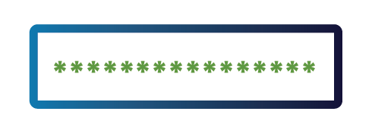
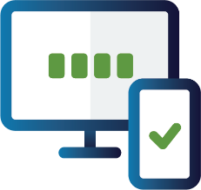

Four cybersecurity essentials
The following four practices are the foundation of organizational cybersecurity and should be as automatic as buckling a seatbelt:
Teach employees to avoid phishing
Recognizing and reporting suspicious emails and links may prevent cyber attacks.
Require strong passwords
Long, random, unique passwords make accounts harder to breach.
Require multifactor authentication
Adds an extra layer of protection if a password is compromised.
Update software
Keeps systems protected against known vulnerabilities.
Are we doing these things, and are they documented in our cybersecurity policy?
Is there room for improvement?
DISCUSSION

Slide 9


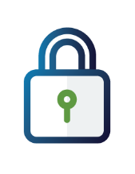

Level up our defenses
Once the core protections are in place, we can strengthen our defenses with additional practices:
Use logging and monitoring
Helps detect suspicious activity early to prevent or limit damage.
Back up data
Ensures you can recover quickly from ransomware or data loss.
Encrypt data
Makes stolen data unreadable without the proper key.
Are we doing these things, and are they documented in our cybersecurity policy?
Is there room for improvement?
Are we doing these things, and are they documented in our cybersecurity policy?
Is there room for improvement?
DISCUSSION

Slide 10

Additional practices
More ways to increase your cybersecurity:
Share cyber incident information with CISA
Early reporting helps protect other organizations and improves national defense.
cisa.gov/report
Migrate to a .gov domain (*for government organizations only)
Builds trust and improves security for public-facing services.
Check eligibility and learn more at get.gov
Are we doing these things, and are they documented in our cybersecurity policy?
Is there room for improvement?
Are we doing these things, and are they documented in our cybersecurity policy?
Is there room for improvement?
DISCUSSION

Slide 11
Promote safer online practices
As an industry leader, it’s essential that [your organization’s name] helps our community by:
Encouraging our partners, vendors, and customers to follow cybersecurity best practices.
Using resources like those found in the Cybersecurity Awareness Month Toolkit to educate individuals.
Together, we can protect against online threats.
What collateral can we share with our community?
What social media platforms or communication channels can we use?
DISCUSSION

Slide 12
Resources & tools
CISA’s Cybersecurity Awareness Month web page includes free resources we can use:
    Cybersecurity Awareness Month toolkit: Customizable tools to help our organization easily participate all month
    Fact Sheets: Teach employees best practices they can use at work and on their personal devices
    IT tools: Implement/strengthen the best practices with Cyber Hygiene Services, Logging Made Easy software and other tools and guidance
Shall we participate in Cybersecurity Awareness Month? Who will head it up?
Who can take the lead on updating our cybersecurity policies and procedures?
DISCUSSION

Slide 13
Next steps
Directions: Use this slide to document any actions agreed upon in the meeting.
…

